Slide 1

Research Methods in Computing and Technology CT098-3-2
Introduction to Disciplines

Slide 2
Topic and structure of the lesson
Introduction to disciplines
The nature of Computing & Technology project
Differences between disciplines
Topics of interest within each discipline
Notes:
Introduction to disciplines
The nature of Computing & Technology research
Differences between disciplines
Topics of interest within each discipline

Slide 3
Learning Outcomes
At the end of this session, you should be able to:
Select an appropriate Computing & Technology research area / title according to the discipline you are in

Slide 4
Nature of Computing and Technology Project
Understand what FYPs are
Within academia ≠ within industry
“Look at things more critically and more deeply”
“Academic projects should provide evidence of a much deeper understanding of what you are doing”
“require some form of justification and contextualization”
“Develop your own thoughts, arguments, ideas and concepts”
“question things, look at things in a new way and from new angles”
---(Dawson,2009)

Slide 5
Nature of Computing and Technology Project…
Understand what FYPs are
Apply what was studied in other modules
Develop new skills
Technical – (Programming language / Tools / Development methods / Design technique / Research)
Personal - (time management / discipline / communication skills / report writing)
Work independently
Make a contribution – that may be used by or benefit others
(Dawson,2009)

Slide 6

Nature of Computing and Technology Project…
Understand what Computing and IT projects are
PROJECT
“is something which has a beginning and an end”
Purpose : to bring about some beneficial change
Need to do more than develop a piece of software – must involve an element of research, justify the context, evaluate and discuss its result

Slide 7
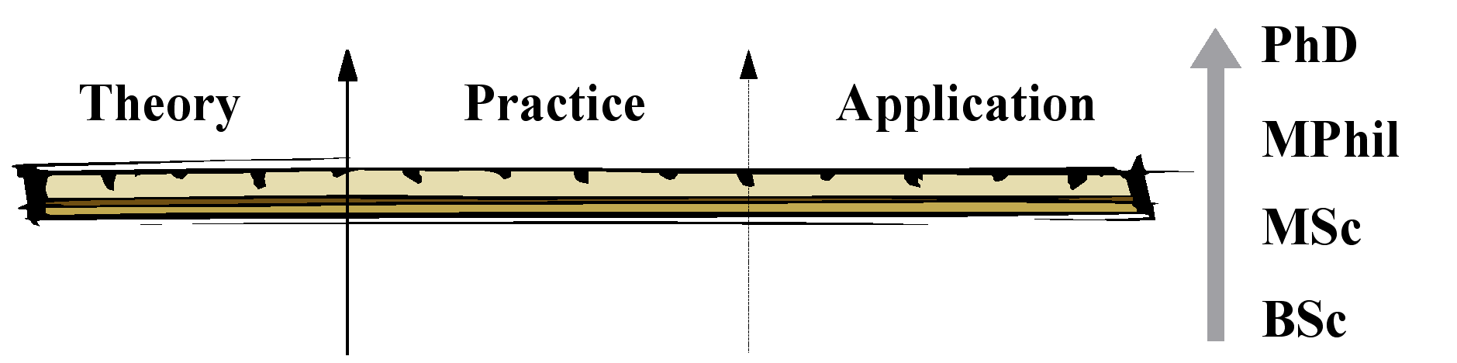
Practice based computing : less on theory, more on development of software systems
Soft issues : application and use of computers and IT;
Influence and impact of IT in organizations and society
Theoretical areas : mathematics, logic, formal methods and AI
Notes:
Hard Sciences and Soft Sciences

Slide 8
Computing Project Types
Research based
Development
Evaluation
Investigation of a particular area, improving understanding of the area
Development of hardware, software, process models, methods, algorithms, theories, designs and requirements specification
Comparing several approaches to a particular problem; evaluating two or more programming languages; considering alternative and new technological approaches to a problem.
Industry-based
Solving a problem within either an organization or another university department.
Problem solving
Developing a new technique to solve a problem; applying existing problem solving technique or theory to a new area;

Slide 9
Principles in choosing a project
Capable of doing in the time available
Is it your interest?
According to your personal development and assist in your goals
Have a serious purpose and clear outcome that will benefit someone
Have clear deliverables
Suitably linked with your program
Sufficient scope and quality to fit the program
Resources available

Slide 10
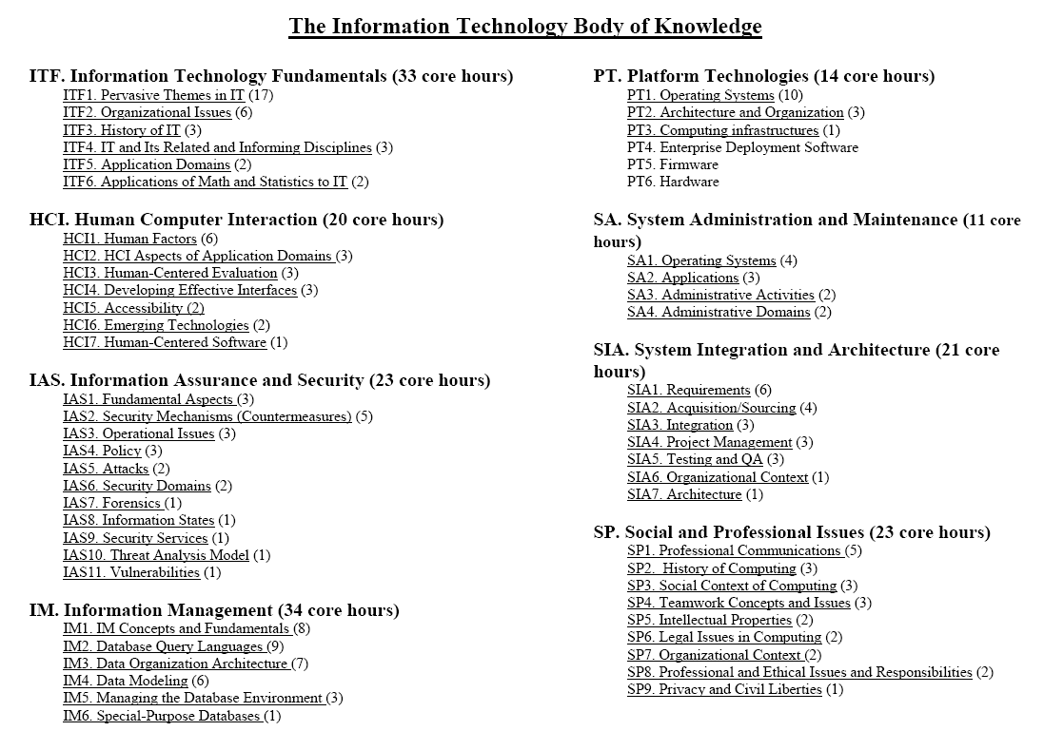
http://www.acm.org/education/curric_vols/IT_October_2005.pdf
Notes:
Body of knowledge represents the world’s understanding, theories, concepts, models, the sciences and the arts. This knowledge is stored in books, journal articles, conference proceedings, documents, reports, the Internet, people’s mind.

Slide 11
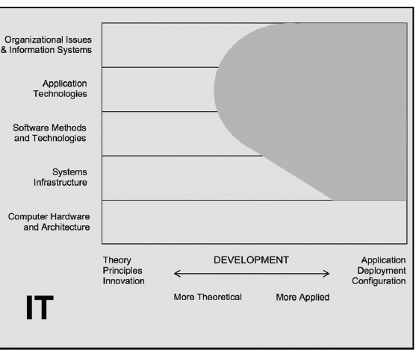
Body of Knowledge in IT

Slide 12
Body of Knowledge in SE
SE
Software Design
Software Processes
Requirements Specification
Software Verification and Validation
Software Evolution
Software Reliability
Formal Methods
Risk Assessments

Slide 13
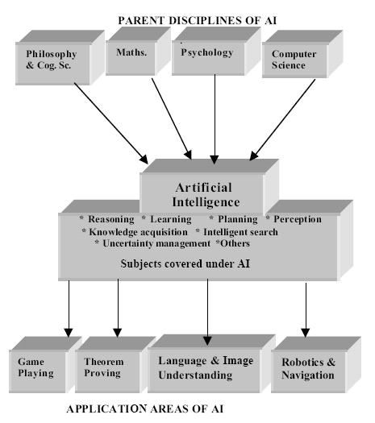
Body of Knowledge in AI (Intelligent Systems)
Taken from : http://www.learnartificialneuralnetworks.com/ai.html#generalproblemsolving

Slide 14
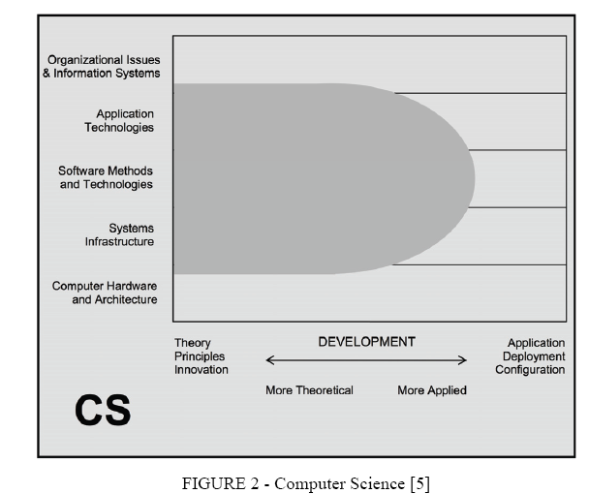
Body of Knowledge in Computer Science

Slide 15
Techniques and Information Sources
Past projects
lecturers
Talking with peers
Reading around subject areas

Slide 16
Clustering
List keywords
When exhausted all words and phrases possible, cluster them
Used to develop
Research Territory Maps (RTMs) – how topics relate to one another in a particular field
Relevance Trees – similar to RTM but has hierarchical structure lower levels of detail; identifying how a subject is composed;
Spider Diagrams – similar to RTMs (how topics relate) and relevance trees (how topics break down from central idea, subject or research question).

Slide 17
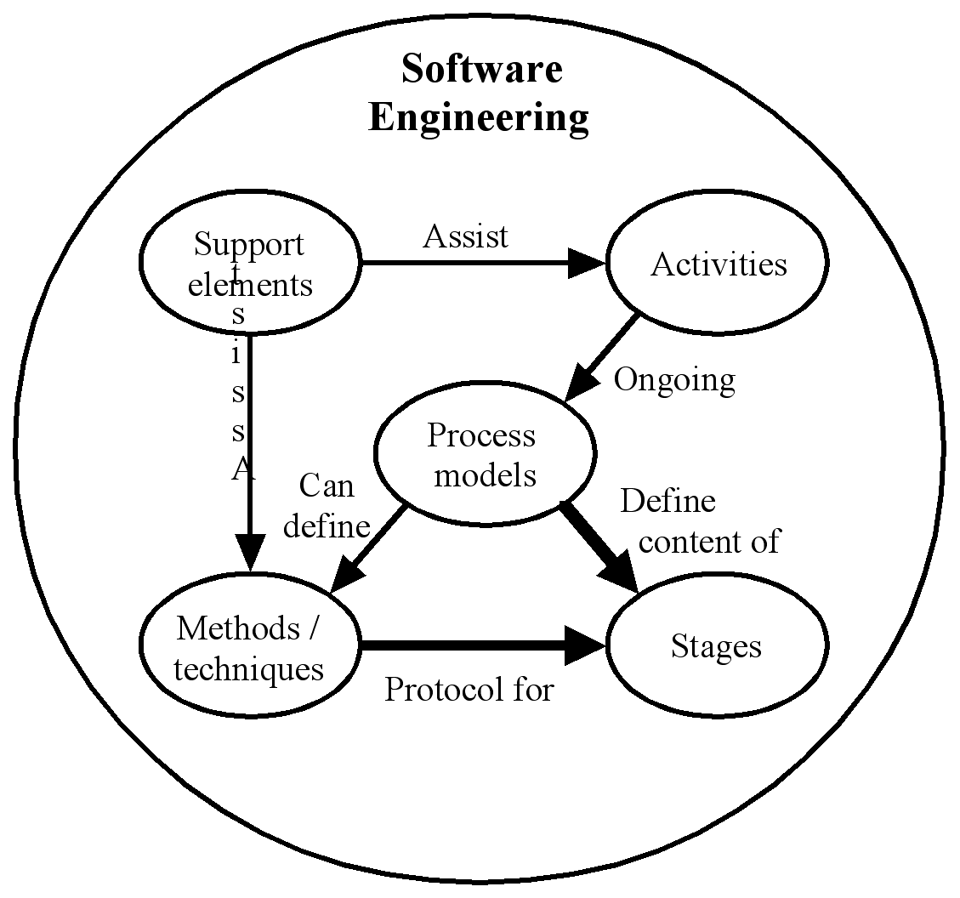
A high-level RTM for the field of software engineering

Slide 18
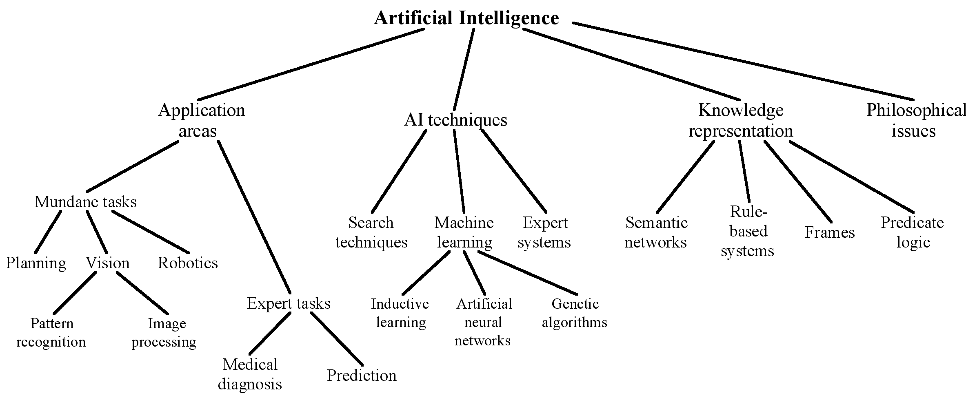
An example relevance tree for the field of artificial intelligence

Slide 19
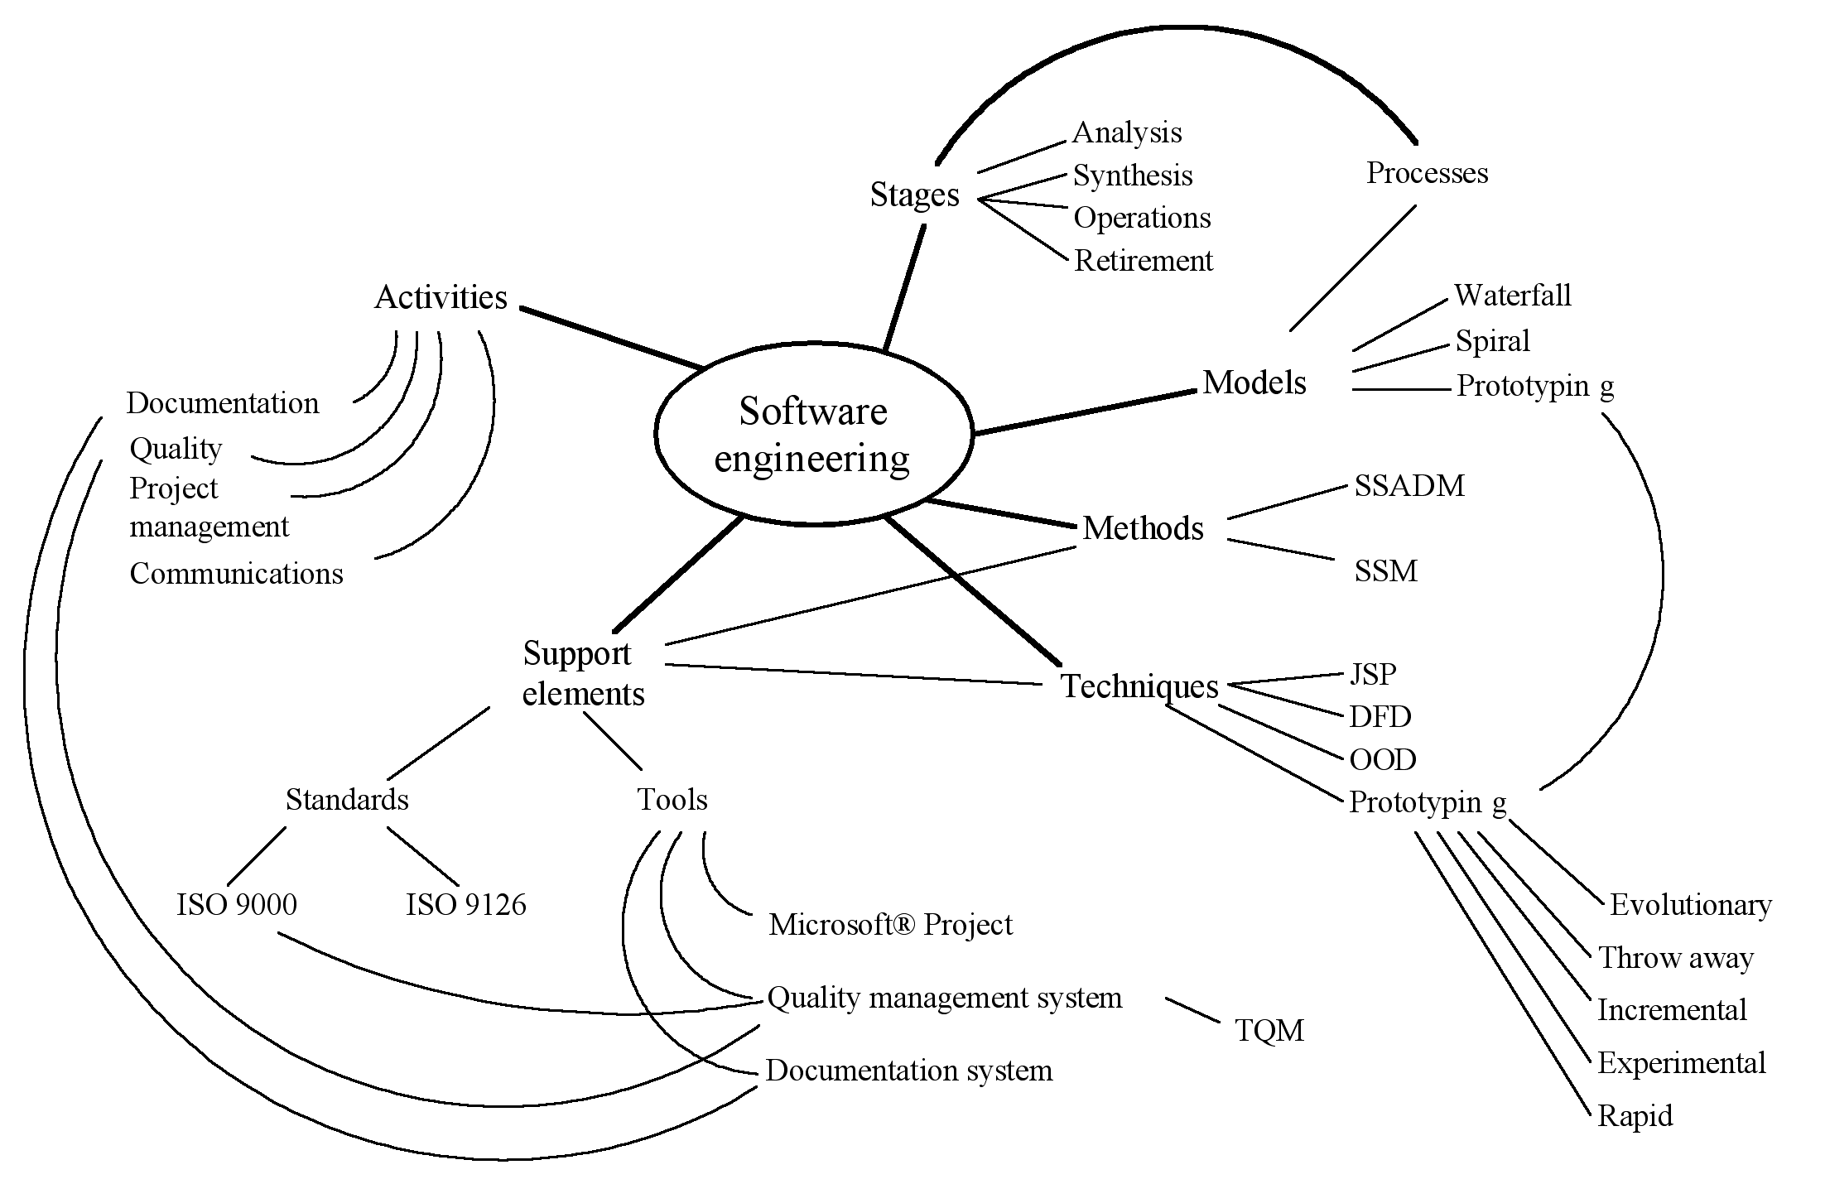
An example spider diagram for the field of software engineering

Slide 20
Topics of interest within each discipline
Look at various research papers to identify the various topics of interest within each of your discipline

Slide 21
Question and Answer Session
Q & A

